Slide 1
Nexthikes it solutions
LLM Project: Building a News Research Tool
-Ankita babar

Slide 2
Project Overview :-
A web-based application for searching latest news.
Fetches real-time articles using News API.
Displays article title, source, date and image.
Provides quick article summaries.
Offers search history, saved articles and export options
Main Goal:
Make news research faster, simpler and more organized.

Slide 3
Problem Statement:-
Problem Statement
Finding and understanding news from multiple sources can be time-consuming.
Major Problems:
Too many news sources
Long articles require more reading time
Difficult to track previous searches
Important articles may be lost
No simple research-focused interface

Slide 4
Our Solution:-
One application
Search
Summarize
Save
Export

Slide 5
Objectives:-
Project Objectives
Search news by any topic
Fetch latest articles
Generate concise summaries
Restrict access using authentication
Save useful articles
Export summaries
Maintain search history

Slide 6
Technologies Used :-
Technology Stack
Technology | Purpose
Python | Application development
Streamlit | Web interface
NewsAPI | Fetch latest news
LangChain | AI workflow integration
OpenAI | Summarization integration
HTML/CSS | UI customization
dotenv | API key management

Slide 7
Application Workflow:-
How the System Works
1. Login → User authentication
2. Search → Enter any news topic
3. Fetch → NewsAPI retrieves articles
4. Process → Articles are processed
5. Summarize → Short summary is generated
6. Display → News shown in cards
7. Save/Export → User can save or download results

Slide 8
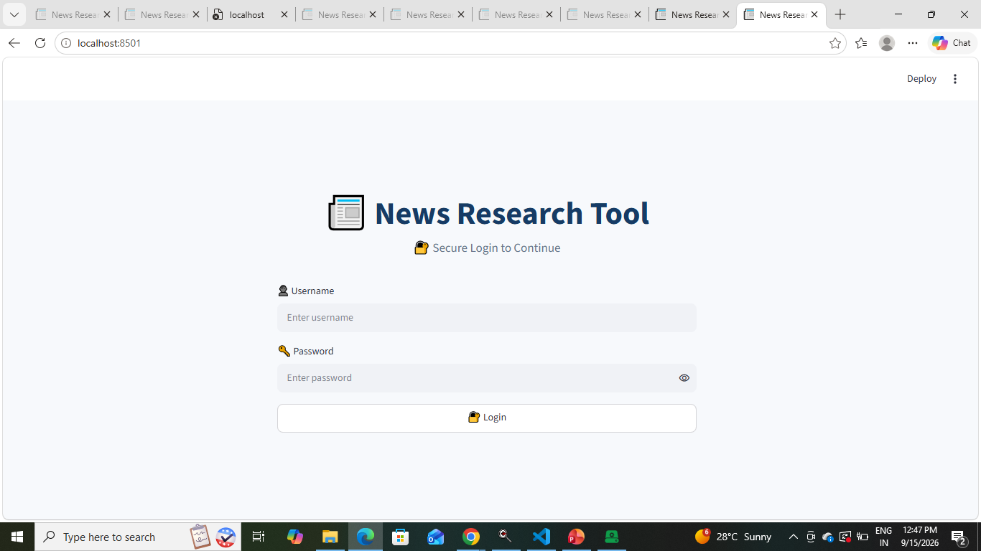
User Authentication:-
Secure login before accessing the application
Username and password verification
Logout functionality
Restricts unauthorized access

Slide 9
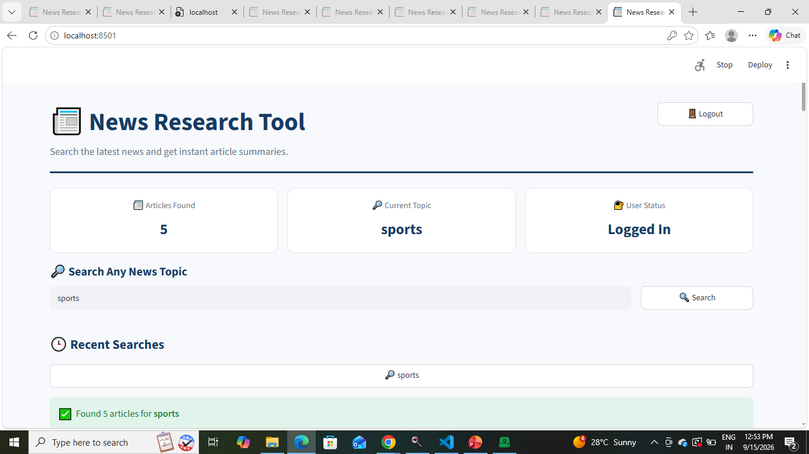
News Search Dashboard:-
News Search Dashboard
Search any news topic
Latest articles displayed instantly
Current topic and article count visible
Recent searches available for quick access

Slide 10
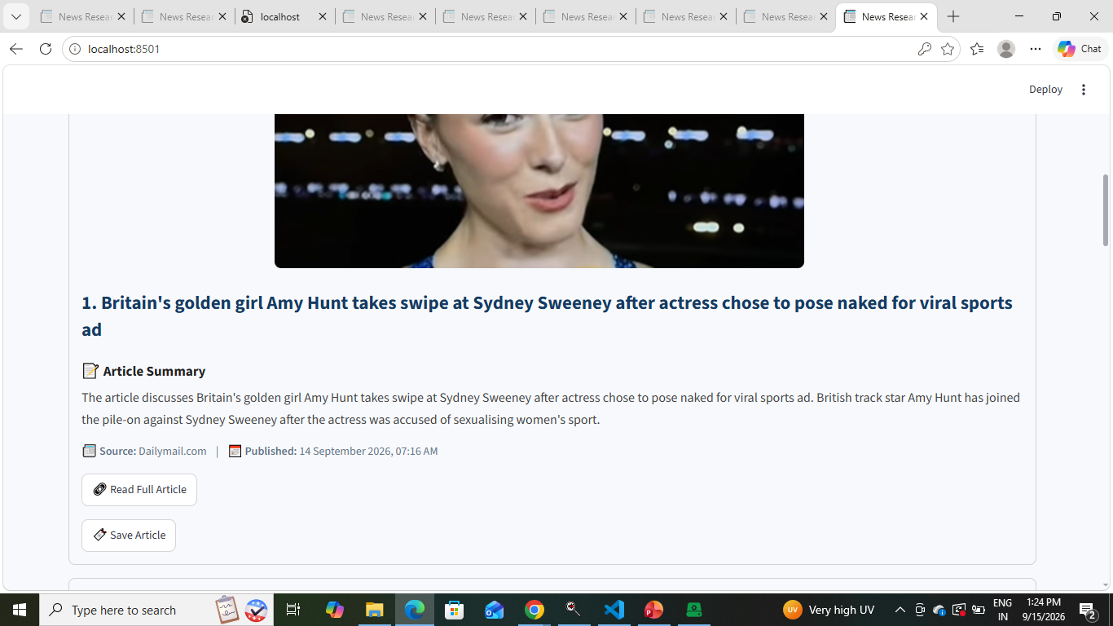
Article Results & Summarization:-
Article Results & Summarization
Each article displays:
Article title
Short summary
Article image
Source
Publication date
Full article link

Slide 11
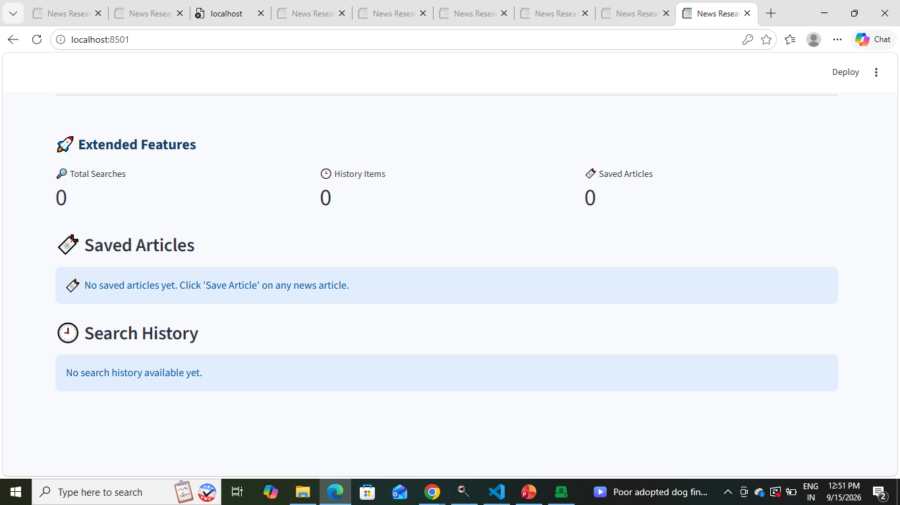
Extended Features:-
Extended Functionality
Save Articles
Save important articles for later.
Search History
Access previously searched topics.
Export Summaries
Download news summaries as a text file.
Search Statistics
Track searches, history items and saved articles.

Slide 12
How Challenges Were Overcome :-
Solutions Implemented
NewsAPI Issues
→ Added error handling and validation.
AI/API Limitations
→ Implemented a fallback summary using article descriptions.
UI Challenges
→ Used Streamlit components + custom CSS.
Session Management
→ Used Streamlit session state.
Search Management
→ Added recent search history.
Additional Functionality
→ Added save and export features.

Slide 13
Extended Features :-
Challenges Faced During Development
Challenge | Impact
NewsAPI integration | Fetching news data
API errors | Data retrieval issues
AI API limitations | Summarization dependency
Streamlit UI design | Professional presentation
Session management | Login & history handling
Data persistence | Saving articles/searches

Slide 14
Results & Conclusion:-
Results
The application successfully provides:
Secure user login
Real-time news search
Article summaries
Professional Streamlit dashboard
Recent search history
Saved articles
Summary export
Full article access
Conclusion
News Research Tool simplifies the process of discovering, understanding and organizing news in one platform.

Slide 15
Thank you !!

